Slide 1
Introduction to Digital Marketing Channels
Intent-Based Marketing (Search Marketing)
A user typing any combinations of words (known as keywords in search terminology)
into an input space (called a search-box)
through usage of search technologies (crawling and indexing)
application of complex programs (known as search algorithms)
delivering the best matched weblinks (known as Organic Search results) and
displaying paid weblinks (known as Pay Per Click)

Slide 2
History of Search Engine Marketing
Search engine marketing as a channel goes back to 1996 when the search engine OpenText initiated the paid search business model.
In 2003, GoTo.com was purchased by search engine Yahoo
In 2000, Google launched the AdWords program
Ask.com with its services in 2005 called Ask Sponsored Listings and soon after MSN followed it in 2006

Slide 3
How Search Engines Support Marketing
Crawling and indexing: A search engine’s main job is to crawl and index the billions of websites, their content (text, audio, video), and other unstructured files and data which typically would not be easy to locate and access by a common user.
Mapping and serving most relevant content: includes ranking the crawled and indexed content with pre-defined parameters to filter and present the most relevant answers to a particular query put up by the user through his/her keywords.

Slide 4
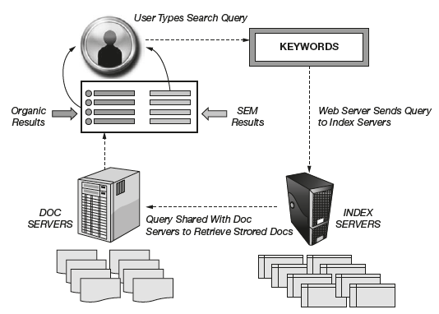
Working of Search Engines

Slide 5
Brand-Based Marketing (Display Marketing)
History of Display Marketing
First instance of online advertising in the 1980s between IBM and Sears, which started displaying banners at the bottom of the screen to promote Sears
The first clickable web ad was sold by Global Network Navigator (GNN) in 1993 to a Silicon Valley law firm.
Hotwired ,in 1994 became the first website to sell large volumes of banner ads

Slide 6
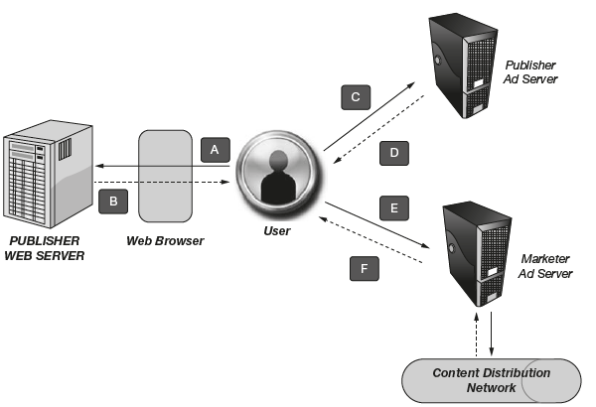
Delivery Method (How an Ad Is Served)

Slide 7
Key Display Ecosystem Players
Ad network
Ad exchange
DSP (demand side platforms)
SSP (supply side platforms)
ATD (agency trading desks)

Slide 8
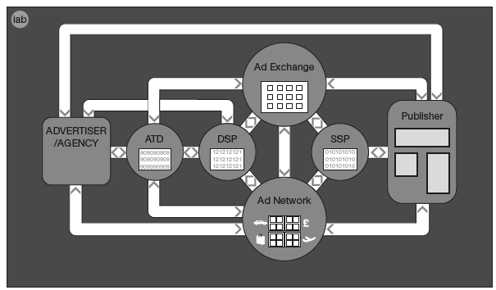

Slide 9
Community-Based Marketing (Social Media Marketing)
Types of Social Media Marketing
Engagement (through dedicated pages)
Advertising (through native/content ads)
Viral platforms (through network effects)
Idea/concept testing (through crowdsourcing)
Customer feedback (through listening tools)
Learning platforms (through gamification concepts)

Slide 10
Advantages of Social Media Marketing
Best channel to develop user following
The humanizing effect
Best channel to begin with a lean budget
Improved customer insights

Slide 11
Partner, Direct, Content, and Platform-Based Marketing Channels
Partner Marketing
Affiliate marketing
Public relations
Editorial partnerships

Slide 12
Direct Marketing
Outbound Marketing (E-mail/SMS)
Inbound marketing (customer service calls/toll free numbers)
Response marketing (user comments)

Slide 13
Content Marketing
Owned content (website/blog content/webinars)
Paid content (native content)
Viral content (video marketing)

Slide 14
Platform Marketing
Device marketing (mobile/wearables)
Platform marketing (kiosk marketing)
Media marketing (in-game marketing)

